Slide 1

Multiple Regression and Dummy Variables
Professor Harry Krashinsky
EMBA 46, QRM 2025

Slide 2
Dummy Variables
One of the types of variables that we’ve not yet discussed is called a “dummy variable”.
These types of variables are also called indicator variables, but the main thing to know about them is that they are different from most variables we encounter.

Slide 3
Most variables, like education, age, income, etc. will take on a variety of different values.
But dummy variables can only take two different possible values: zero or one. And they are structured in this way in order to “indicate” membership in a particular group.

Slide 4
Example #1 of a Dummy Variable
A dummy variable can represent people above a particular age in your sample if you have a dummy variable called “AgeAbove45”, defined as follows:
“AgeAbove45” = 1 if the person’s age is above 45 years
“AgeAbove45” = 0 if the person’s age is at or below 45 years

Slide 5
Example #2 of a Dummy Variable
A dummy variable can represent labour union members in your sample if you have a dummy variable called “union”, defined as follows:
“Union” = 1 if the person is a union member
“Union” = 0 if the person is not a union member

Slide 6
You get the idea.
Although these appear simplistic, dummy variables can be extremely useful for us in a number of different ways.
Let’s review some of the various things that they can do.

Slide 7
Dummy Variables and Conditional Means
We’ve already been through this two-word definition of a regression. But as it happens, dummy variables are particularly good at calculating relative differences such as conditional means between groups.
Why? To motivate this, consider revisiting a really early example of regressions we discussed

Slide 8
An old example
Remember the first regression we saw in our online videos? It looked like this:
Y = 20 + (1)X

Slide 9
An old example
With this example, we first discussed the way in which we could understand a regression as a conditional mean.
We argued that specific values of X could be matched with specific means in Y

Slide 10
An old example
In fact, we set up a table like this:
X |  | Conditional Mean of Y
1 |  | 21
2 |  | 22
3 |  | 23
4 |  | 24
5 |  | 25

Slide 11
An old example
But what if X = 0? What would be the conditional mean of Y in this case?
Y = 20 + 1(0) = 20
So what does this tell us?
Here, the intercept captures the conditional mean when X = 0

Slide 12
An old example
This is a relatively easy point, but it turns out to be exceptionally important for thinking about the interpretation of dummy variables.
Specifically: understanding how you think about the intercept in the context of a conditional mean is critical for what we’re about to do.

Slide 13
Conditional Mean Example #1
Let’s suppose that we have a sample of workers at a firm, and we are asked to explore whether or not workers older than 45 are paid differently from workers who are 45 and younger.
Suppose that workers older than 45 earn $20/hour on average, while workers who are 45 and younger earn $17/hour on average.

Slide 14
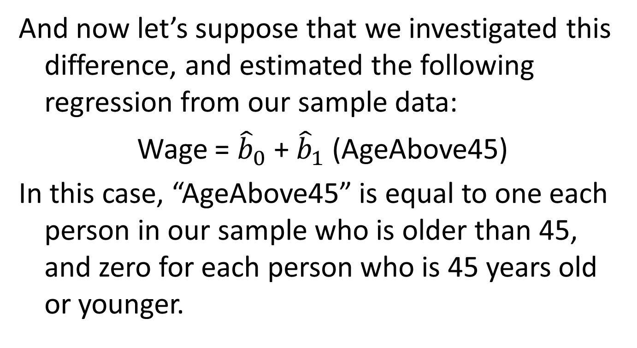
Conditional Mean Example #1
And now let’s suppose that we investigated this difference, and estimated the following regression from our sample data:
Wage = ${\hat{b}}_{0}$ + ${\hat{b}}_{1}$ (AgeAbove45)
In this case, “AgeAbove45” is equal to one each person in our sample who is older than 45, and zero for each person who is 45 years old or younger.

Slide 15
Conditional Mean Example #1
Given the information we have about average earnings for those above 45 years of age and those who are 45 and younger, what will be the value of each coefficient?
Let’s consider what the regression looks like for both groups.

Slide 16
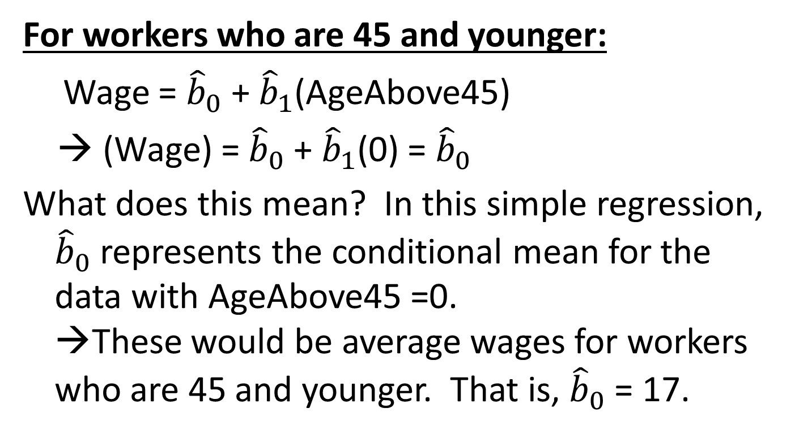
Conditional Mean Example #1
For workers who are 45 and younger:
Wage = ${\hat{b}}_{0}$ + ${\hat{b}}_{1}$(AgeAbove45)
→ (Wage) = ${\hat{b}}_{0}$ + ${\hat{b}}_{1}$(0) = ${\hat{b}}_{0}$
What does this mean? In this simple regression, ${\hat{b}}_{0}$ represents the conditional mean for the data with AgeAbove45 =0.
→These would be average wages for workers who are 45 and younger. That is, ${\hat{b}}_{0}$ = 17.

Slide 17
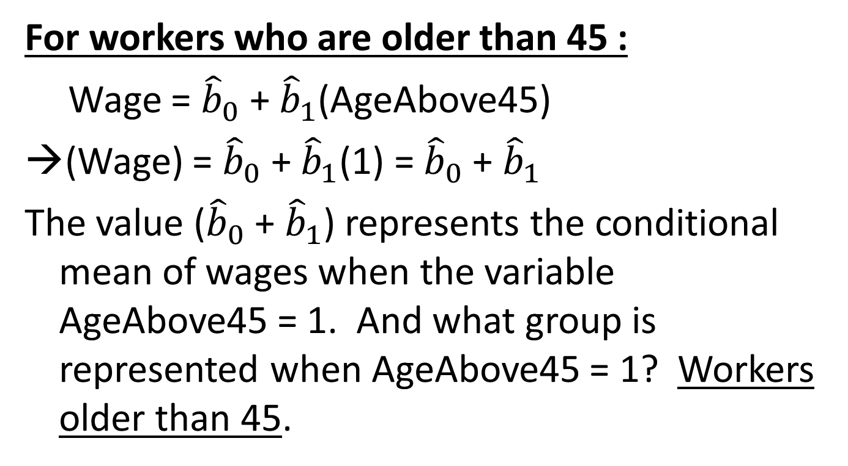
Conditional Mean Example #1
For workers who are older than 45 :
Wage = ${\hat{b}}_{0}$ + ${\hat{b}}_{1}$(AgeAbove45)
→(Wage) = ${\hat{b}}_{0}$ + ${\hat{b}}_{1}$(1) = ${\hat{b}}_{0}$ + ${\hat{b}}_{1}$
The value (${\hat{b}}_{0}$ + ${\hat{b}}_{1}$) represents the conditional mean of wages when the variable AgeAbove45 = 1. And what group is represented when AgeAbove45 = 1? Workers older than 45.

Slide 18

Conditional Mean Example #1
But we already know that average wages for workers who are older than 45 is equal 20
So 20 = ${\hat{b}}_{0}$ + ${\hat{b}}_{1}$

Slide 19
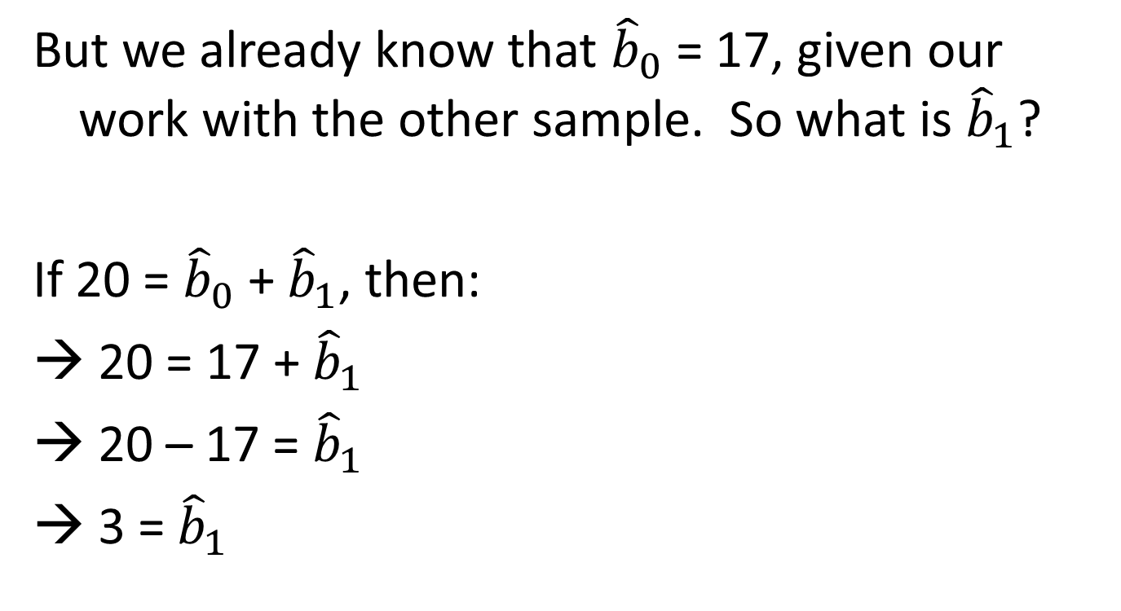
Conditional Mean Example #1
But we already know that ${\hat{b}}_{0}$ = 17, given our work with the other sample. So what is ${\hat{b}}_{1}$?
If 20 = ${\hat{b}}_{0}$ + ${\hat{b}}_{1}$, then:
→ 20 = 17 + ${\hat{b}}_{1}$
20 – 17 = ${\hat{b}}_{1}$
3 = ${\hat{b}}_{1}$

Slide 20
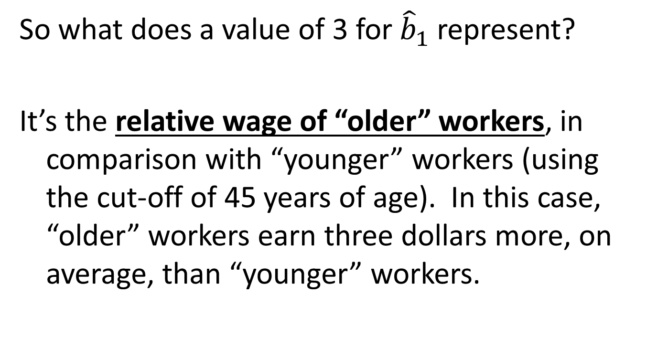
Conditional Mean Example #1
So what does a value of 3 for ${\hat{b}}_{1}$ represent?
It’s the relative wage of “older” workers, in comparison with “younger” workers (using the cut-off of 45 years of age). In this case, “older” workers earn three dollars more, on average, than “younger” workers.

Slide 21
Conditional Mean Example #1
So what would our estimated regression look like here?
(Wage) = 17 + 3(AgeAbove45)

Slide 22
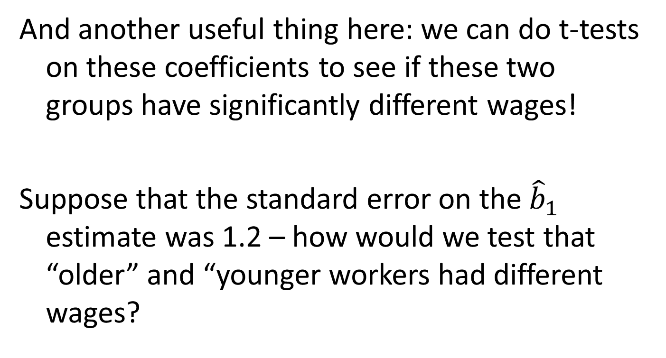
Conditional Mean Example #1
And another useful thing here: we can do t-tests on these coefficients to see if these two groups have significantly different wages!
Suppose that the standard error on the ${\hat{b}}_{1}$ estimate was 1.2 – how would we test that “older” and “younger workers had different wages?

Slide 23
Conditional Mean Example #1
We would set up our null hypothesis:
H₀: β₁ = 0
H_{a}: β₁ ≠ 0
(Note – we’re setting up a null that we may be able to reject. And if we do reject it, what would we conclude about wage differences between the two groups?)

Slide 24
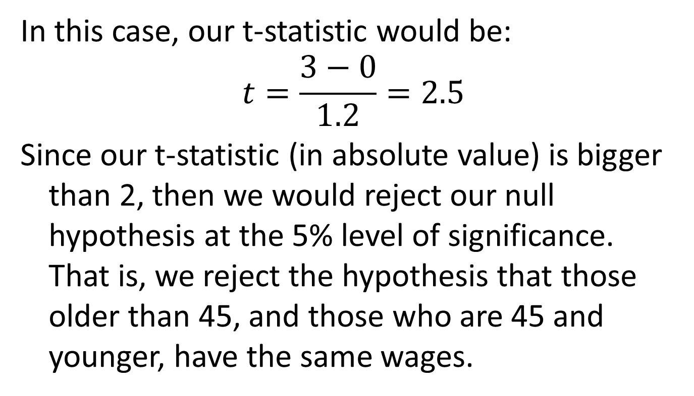
Conditional Mean Example #1
In this case, our t-statistic would be:
$$t=\frac{3−0}{1.2}=2.5$$
Since our t-statistic (in absolute value) is bigger than 2, then we would reject our null hypothesis at the 5% level of significance. That is, we reject the hypothesis that those older than 45, and those who are 45 and younger, have the same wages.

Slide 25
One last thing about this example
As this case shows, dummy variables often represent relative effects. But relative to what?
Relative to the group not explicitly represented by the dummy variable (sometimes called the “omitted reference category”)

Slide 26
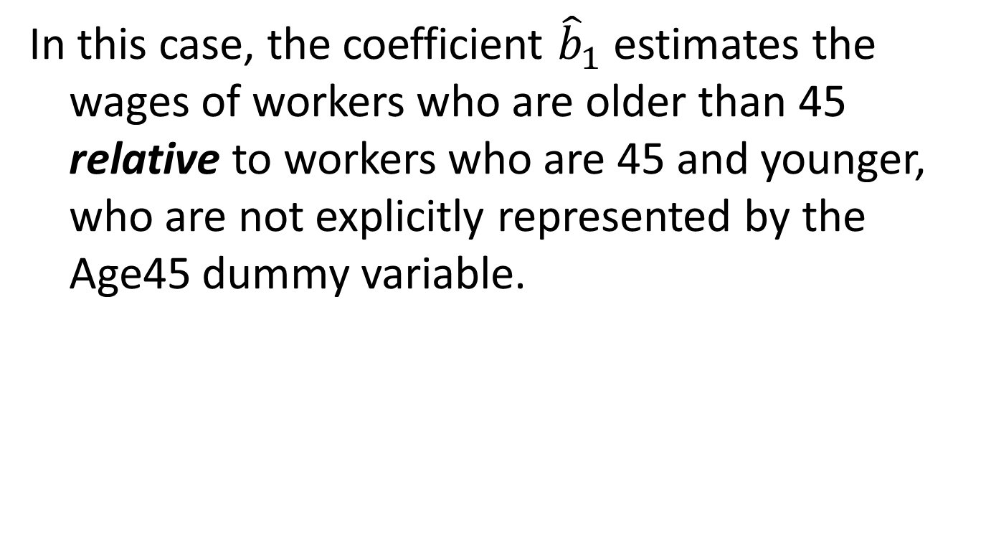
One last thing about this example
In this case, the coefficient ${\hat{b}}_{1}$ estimates the wages of workers who are older than 45 relative to workers who are 45 and younger, who are not explicitly represented by the Age45 dummy variable.

Slide 27
Conditional Mean Example #2
Let’s consider dummy variables in a multiple regression context.
Load up “speeding data.xls” into your Excel program. This data set contains average speeds on the 401 highway under different road and weather conditions.

Slide 28
The variables are:
(i) “Speed”: the average speed on the highway (km/h)
(ii) “Wet”: a dummy variable equal to one if the highway was wet.
(iii) “Snow”: a dummy variable equal to one if there was snow on the highway.
(iv) “Visib”: a dummy variable equal to one if visibility on the highway was poor.
(v) “Congest”: a dummy variable equal to one if the highway was congested with traffic.

Slide 29
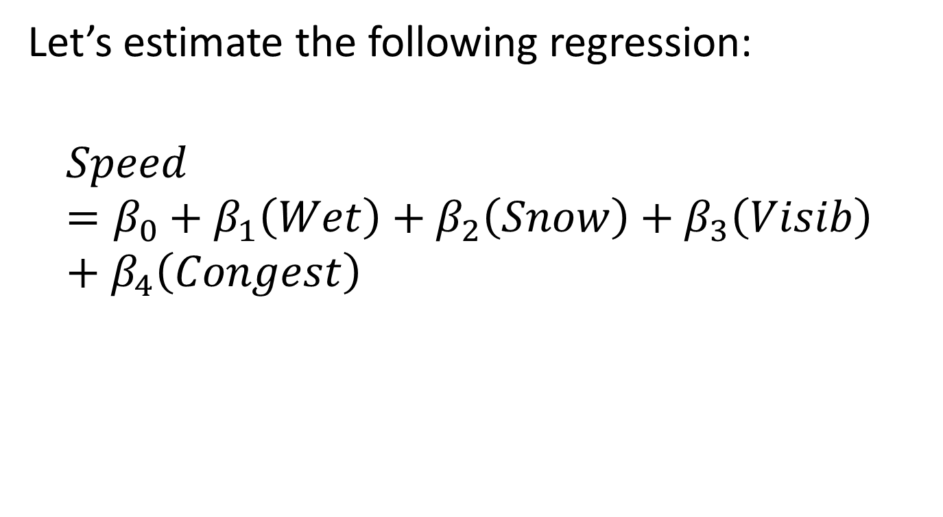
Conditional Mean Example #2
Let’s estimate the following regression:
$$Speed=β_{0}+β_{1}\left(Wet\right)+β_{2}\left(Snow\right)+β_{3}\left(Visib\right)+β_{4}\left(Congest\right)$$

Slide 30
Results
R Square | 0.885387
Standard Error | 9.995144
Observations | 10000
ANOVA | df | SS | MS
Regression | 4 | 7713629 | 1928407
Residual | 9995 | 998529.5 | 99.9029
Total | 9999 | 8712158
 | Coefficients | Standard Error | t Stat
Intercept | 120.0759 | 0.225301 | 532.9581
Wet Road | -14.8773 | 0.199921 | -74.4161
Snow | -19.9808 | 0.199939 | -99.9346
Visib | -30.1321 | 0.199965 | -150.687
Congest | -39.9964 | 0.199952 | -200.03

Slide 31
Simplified Results
R Square | 0.89
Standard Error | 10
Observations | 10000
ANOVA | Df | SS | MS
Regression | 4 | 7713629 | 1928407
Residual | 9995 | 998529.5 | 99.9029
Total | 9999 | 8712158
 | Coefficients | Standard Error | t Stat
Intercept | 120 | 0.225 | 533
Wet Road | -15 | 0.2 | -74
Snow | -20 | 0.2 | -100
Visib | -30 | 0.2 | -150
Congest | -40 | 0.2 | -200

Slide 32
Key question
What do the results actually mean?
As before, the key issue is to recognize that the coefficients represent relative effects.
But relative to what?

Slide 33
The effects represented by the coefficients on the dummies in this regression are relative to the “omitted reference category” – the situation not represented by any of the dummy variables.
In our first case, the omitted reference category was men, but what is it in this case?

Slide 34
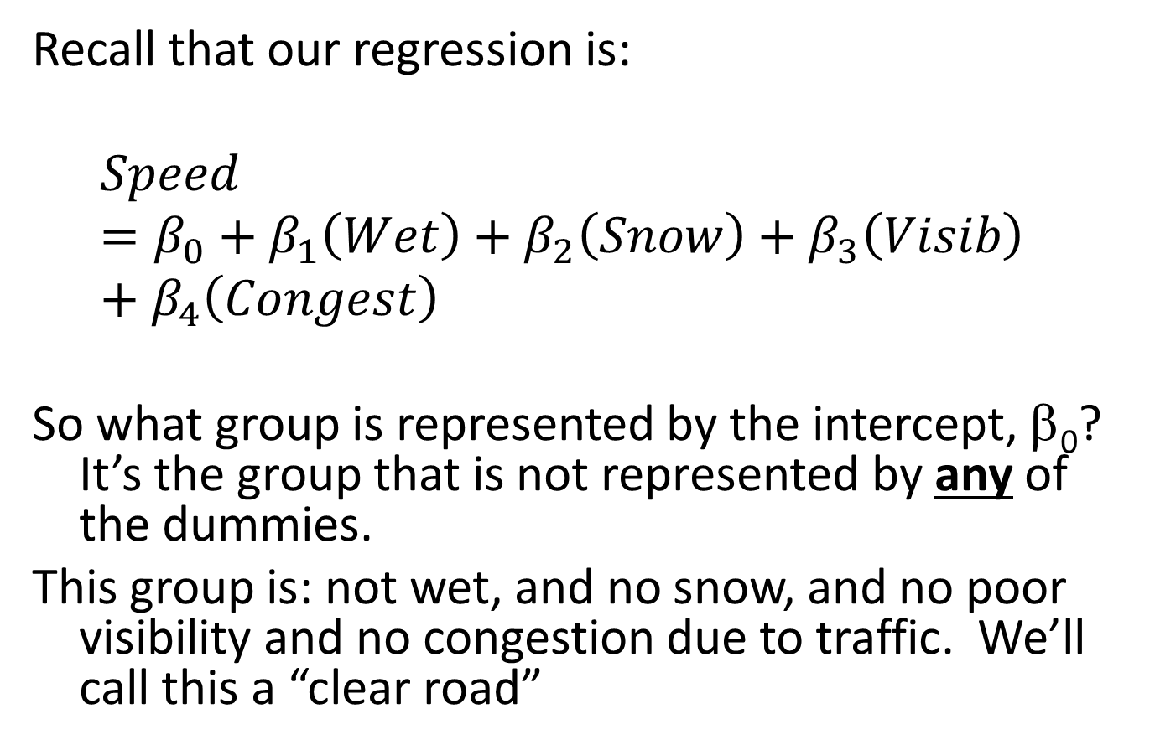
Recall that our regression is:
$$Speed=β_{0}+β_{1}\left(Wet\right)+β_{2}\left(Snow\right)+β_{3}\left(Visib\right)+β_{4}\left(Congest\right)$$
So what group is represented by the intercept, β₀? It’s the group that is not represented by any of the dummies.
This group is: not wet, and no snow, and no poor visibility and no congestion due to traffic. We’ll call this a “clear road”

Slide 35
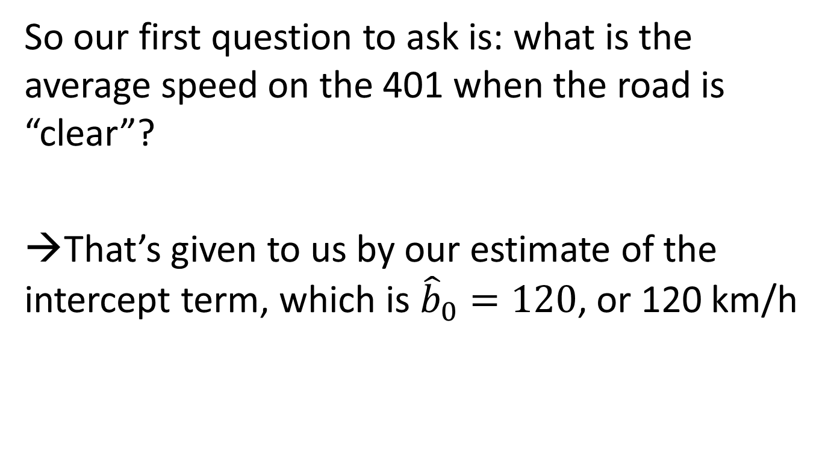
Application
So our first question to ask is: what is the average speed on the 401 when the road is “clear”?
→That’s given to us by our estimate of the intercept term, which is ${\hat{b}}_{0}=120$, or 120 km/h

Slide 36
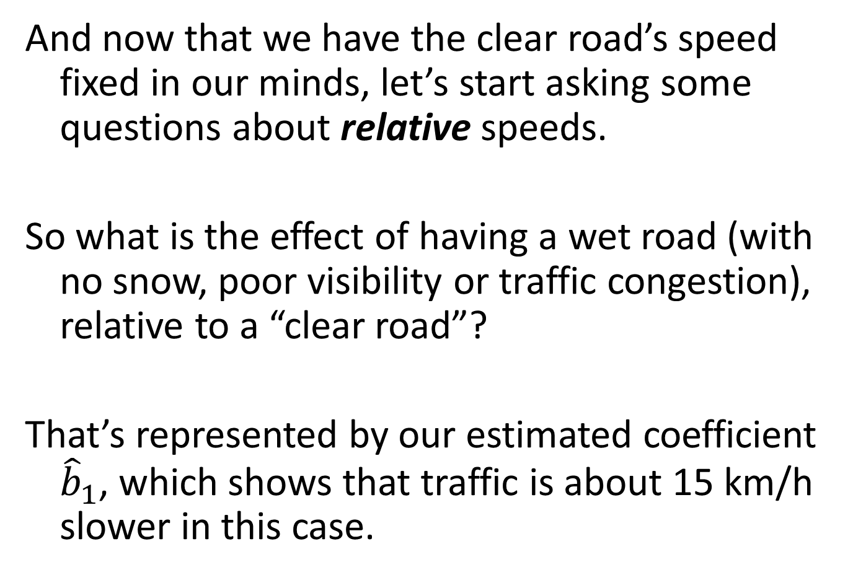
And now that we have the clear road’s speed fixed in our minds, let’s start asking some questions about relative speeds.
So what is the effect of having a wet road (with no snow, poor visibility or traffic congestion), relative to a “clear road”?
That’s represented by our estimated coefficient ${\hat{b}}_{1}$, which shows that traffic is about 15 km/h slower in this case.

Slide 37
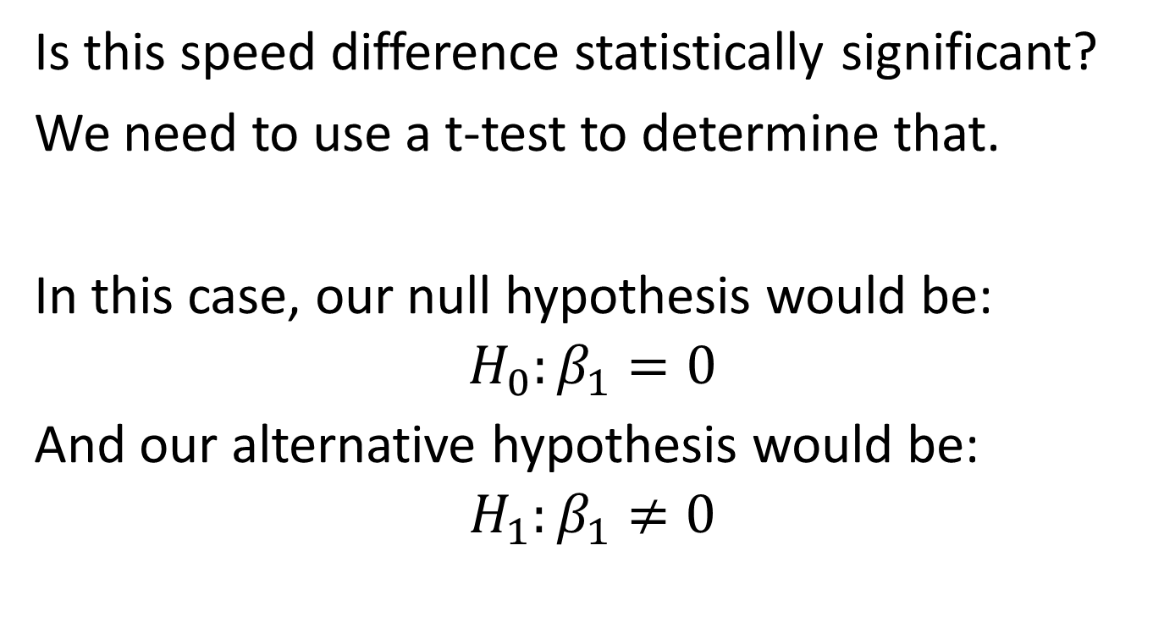
A related question
Is this speed difference statistically significant?
We need to use a t-test to determine that.
In this case, our null hypothesis would be:
$$H_{0}:β_{1}=0$$
And our alternative hypothesis would be:
$$H_{1}:β_{1}≠0$$

Slide 38
Fortunately, we see that Excel calculates this t-statistic for us. The t-statistic is approximately –74, and the absolute value of this number is (very much) larger than 2, so we would suggest that we can reject our null hypothesis that the coefficient is equal to zero. Therefore, the speeds are different when the roads are clear compared to when they are wet.

Slide 39
A slightly more complicated question
Suppose that you had this data and were contracted to do some analysis for the city of Toronto.
The city is concerned about the amount of money to invest in snow clearance during rush hour, and they want to know how slow the roads become under these conditions.

Slide 40
How would you proceed as an analyst?
One way to consider this question would involve the regression we just estimated. You might want to know what average speeds looked like if the roads were congested and snow-covered, but there was no wetness from rain or poor visibility.

Slide 41
Key question #1
What would the predicted average speed be in that case?
Fortunately, we know that a regression can serve as a conditional mean. So we can just use the regression formula to give us the information we want.

Slide 42
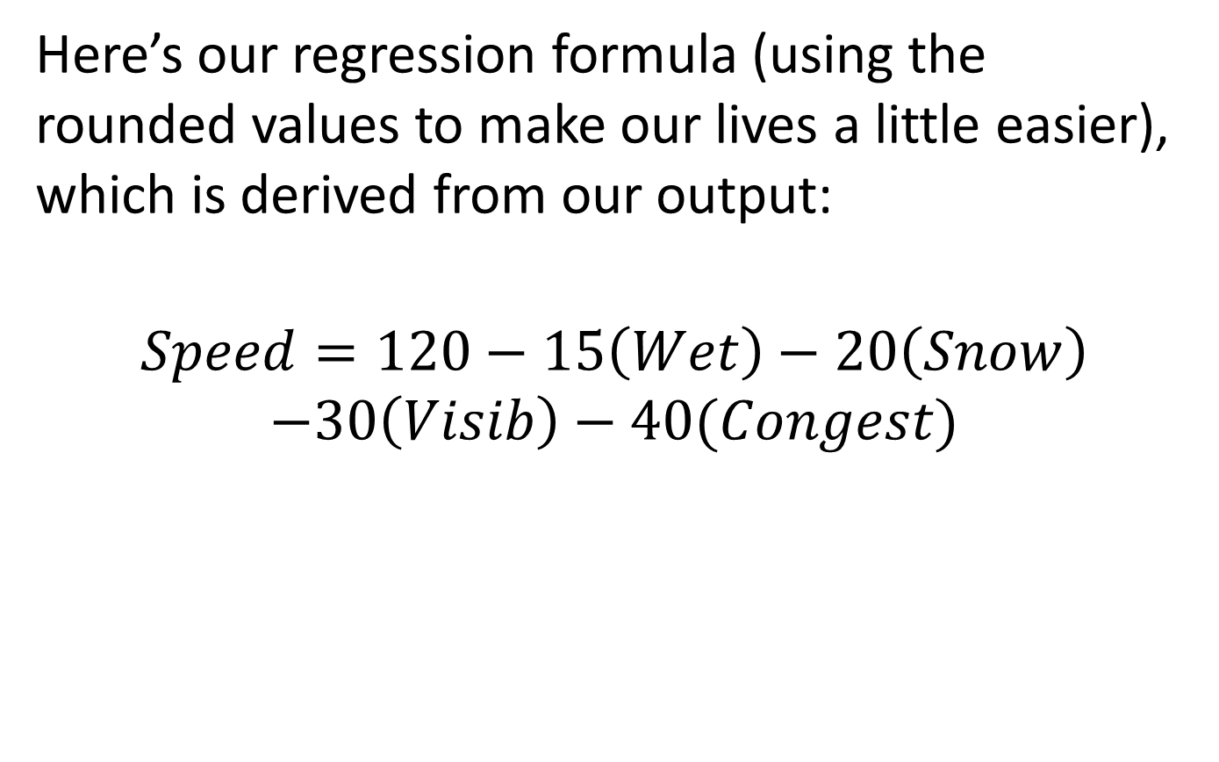
Here’s our regression formula (using the rounded values to make our lives a little easier), which is derived from our output:
$$Speed=120−15\left(Wet\right)−20\left(Snow\right)$$
$$−30\left(Visib\right)−40(Congest)$$

Slide 43
In this case, we want to know the average road speed like if the roads were:
(i) Congested (Congest=1)
(ii) Snow-covered (Snow=1)
(iii) Not wet from rain (Wet=0)
(iv) Not subject to poor visibility (Visib=0)
Plug these values into our regression formula

Slide 44
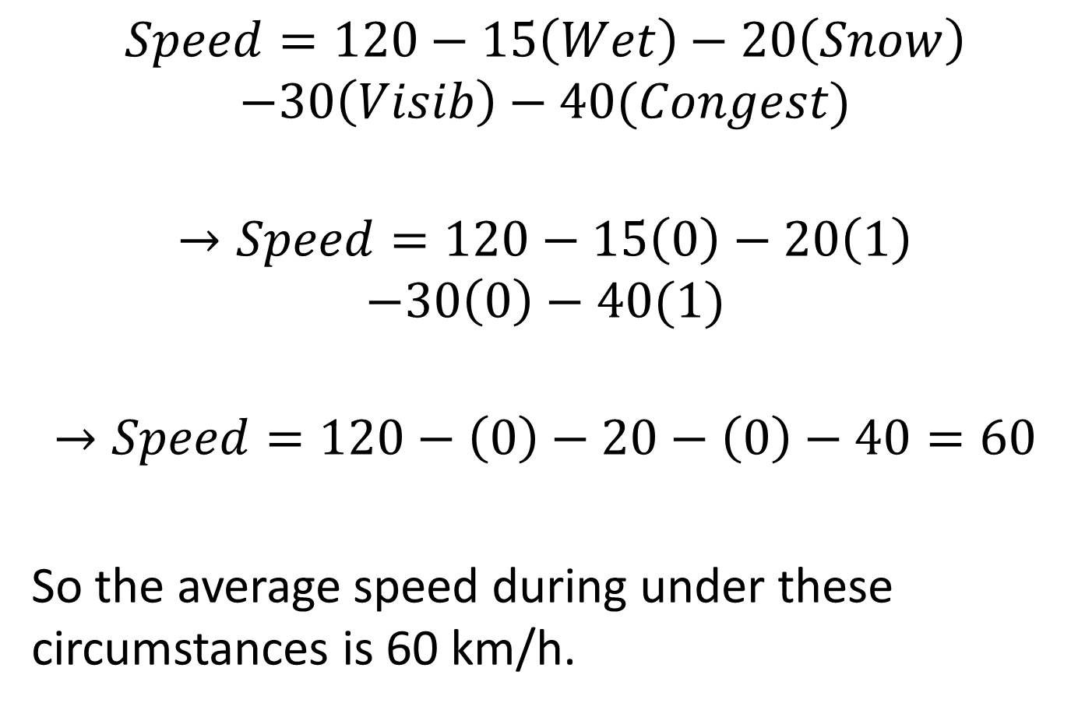
$$Speed=120−15\left(Wet\right)−20\left(Snow\right)$$
$$−30\left(Visib\right)−40(Congest)$$
$$→Speed=120−15\left(0\right)−20\left(1\right)$$
$$−30\left(0\right)−40(1)$$
$$→Speed=120−\left(0\right)−20−\left(0\right)−40=60$$
So the average speed during under these circumstances is 60 km/h.

Slide 45
Key question #2
And can we conceive of a confidence interval in this case?
This is a little more complicated than talking about a confidence interval around a single coefficient. In this case, we would want to be forming a confidence interval around an estimate from our regression. So it’s like we would need a standard error for our regression.

Slide 46
We’ve seen this before, but a brief intuitive recap might be merited.
Let’s think back to what confidence intervals are:
(i) They are ranges around the averages that we calculate from samples we have.
(ii) If we have a normal distribution, then we create a range two standard deviations above and below our mean to construct a 95% confidence interval.

Slide 47
(iii) In the case of regression, we create confidence intervals for our coefficients by creating ranges that are two standard errors (the regression equivalent of a standard deviation) above and below our coefficient estimates. We do this to understand the effect of a single coefficient from our regression.

Slide 48
(iv) We should recognize that our guess of an average speed of 60 km/h when the road is snow-covered and congested is, in a sense, an effect from all of our coefficients. So do we have a standard error for the effect of all of our coefficients?
Yes – it’s the standard error of the regression.

Slide 49
Recall out regression output
R Square | 0.885387
Standard Error | 9.995144
Observations | 10000
ANOVA | df | SS | MS
Regression | 4 | 7713629 | 1928407
Residual | 9995 | 998529.5 | 99.9029
Total | 9999 | 8712158
 | Coefficients | Standard Error | t Stat
Intercept | 120.0759 | 0.225301 | 532.9581
Wet Road | -14.8773 | 0.199921 | -74.4161
Snow | -19.9808 | 0.199939 | -99.9346
Visib | -30.1321 | 0.199965 | -150.687
Congest | -39.9964 | 0.199952 | -200.03

Slide 50
Let’s make our life easy and use the rounded value here and say that the standard error of the regression is about 10.
In this case, then:
Conditional Mean (regression) estimate = 60
Standard error of the regression = 10
What’s the confidence interval?

Slide 51
It’s the usual calculation:
Regression estimate ± 2*Standard error
→ 60 ± 2*10
So the 95% confidence interval is between 40 km/h and 80 km/h.
What can we say about this speed relative to clear conditions?

Slide 52
Another Use of Dummy Variables
Sometimes, as managers, we are presented with statements like:
“Things are looking much better this quarter”
“This reorganization has really improved productivity”
“Our new marketing campaign has been a complete disaster”

Slide 53
Anytime we hear statements like this, we should try to understand them from a statistical standpoint as well as possible.
These are comparative statements. And with your statistical training, you would want to be able to respond to these types of statements in good, careful ways.

Slide 54
But how could you do that?
Regressions and dummy variables will help you immensely with these types of tasks.
Consider three potential changes to productivity that are mapped before and after a reorganizational change at a set of firms

Slide 55
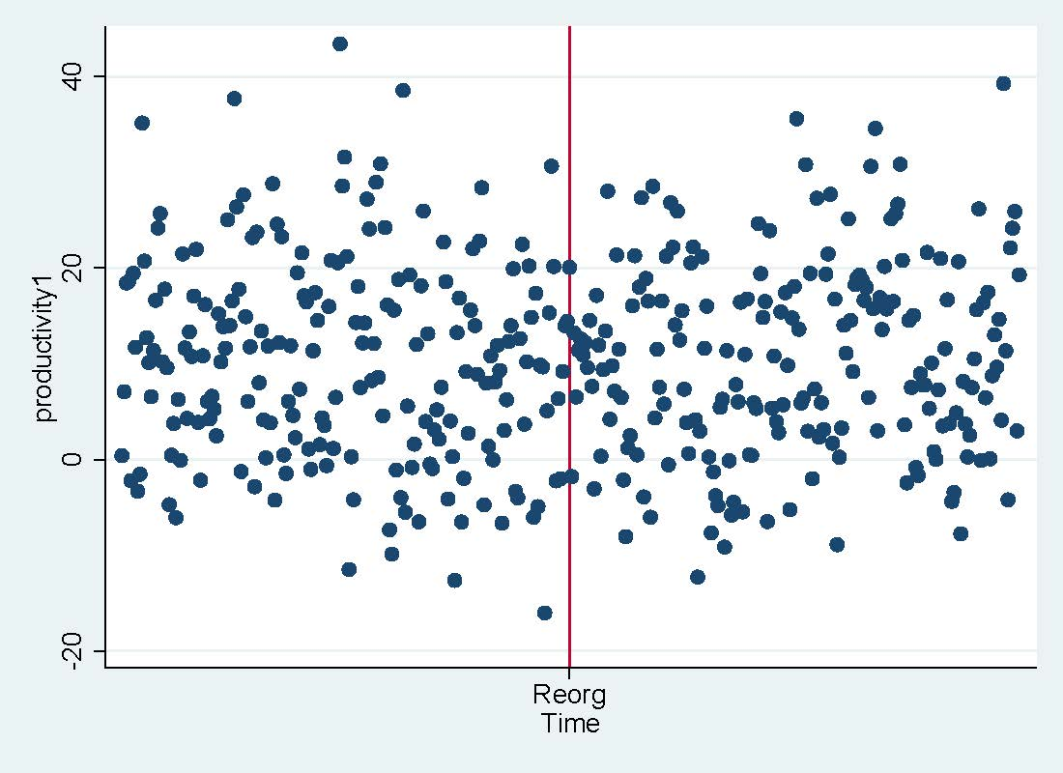
Example #1

Slide 56
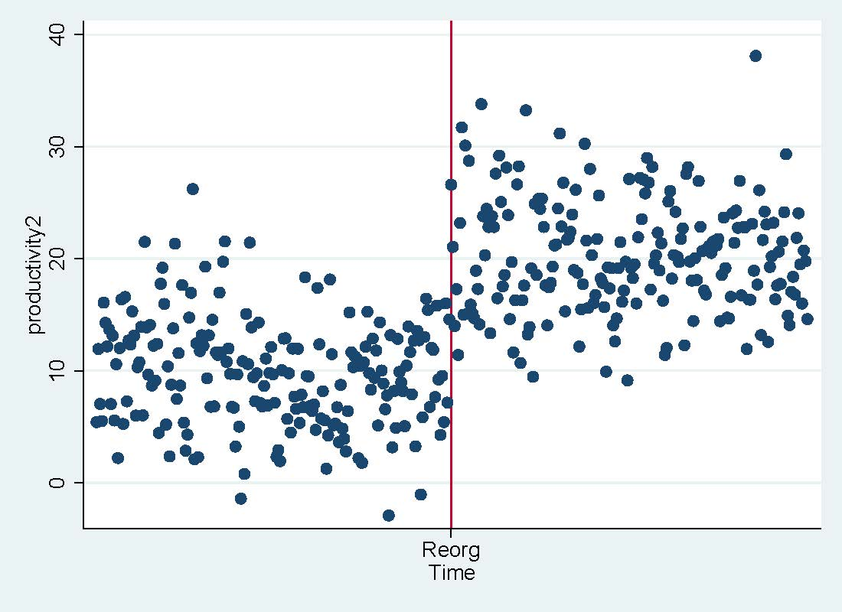
Example #2

Slide 57
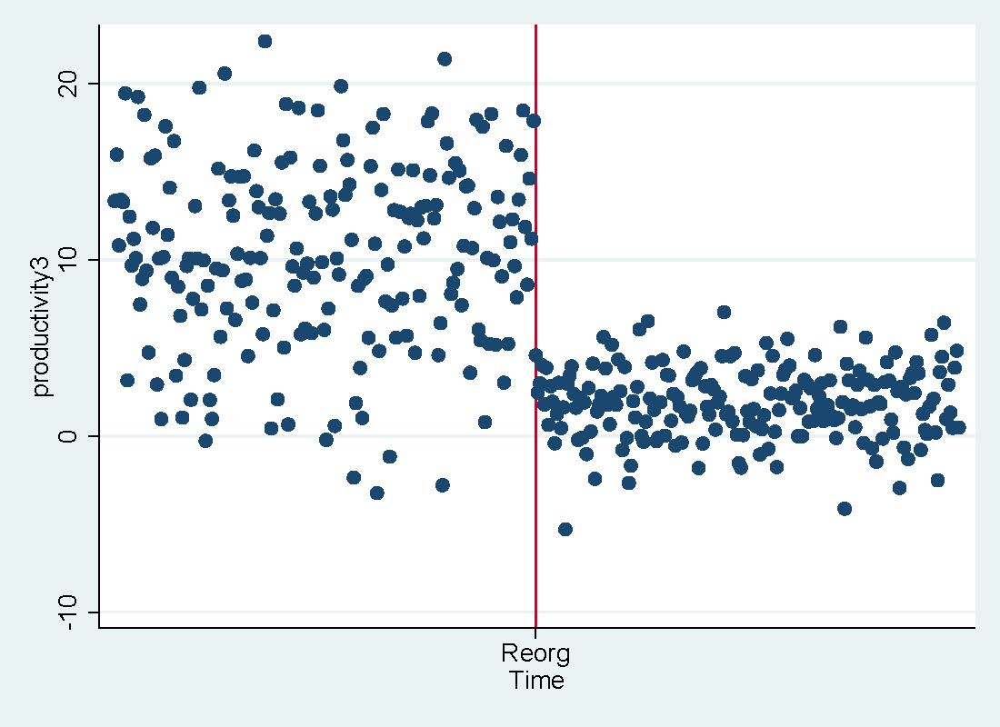
Example #3

Slide 58
For certain, there appear to be changes in productivity for a couple of these examples, but how do we answer this question in a good statistical way?
We need to think about productivity after the reorganizational change relative to the original system.

Slide 59
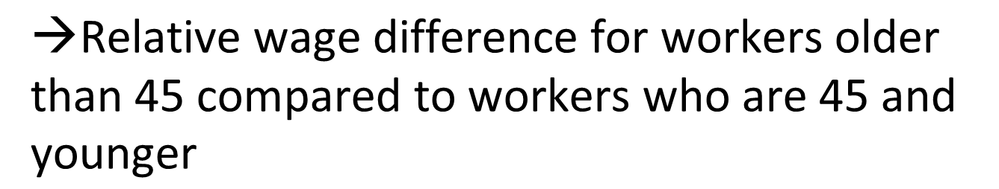
Recall: Wage example
Recall the regression we estimated:
Wage = b₀ + b₁(AgeAbove45)
What’s the interpretation of b₀?
And what’s the interpretation of b₁?
$$\text{→}\text{Average} \text{wages} \text{for} \text{workers}\text{ 45 }\text{and} \text{younger}$$
$$\text{→}\text{Relative} \text{wage} \text{difference} \text{for} \text{workers} \text{older} \text{than}\text{ 45 }\text{compared} \text{to} \text{workers} \text{who} \text{are}\text{ 45 }\text{and} \text{younger}$$

Slide 60
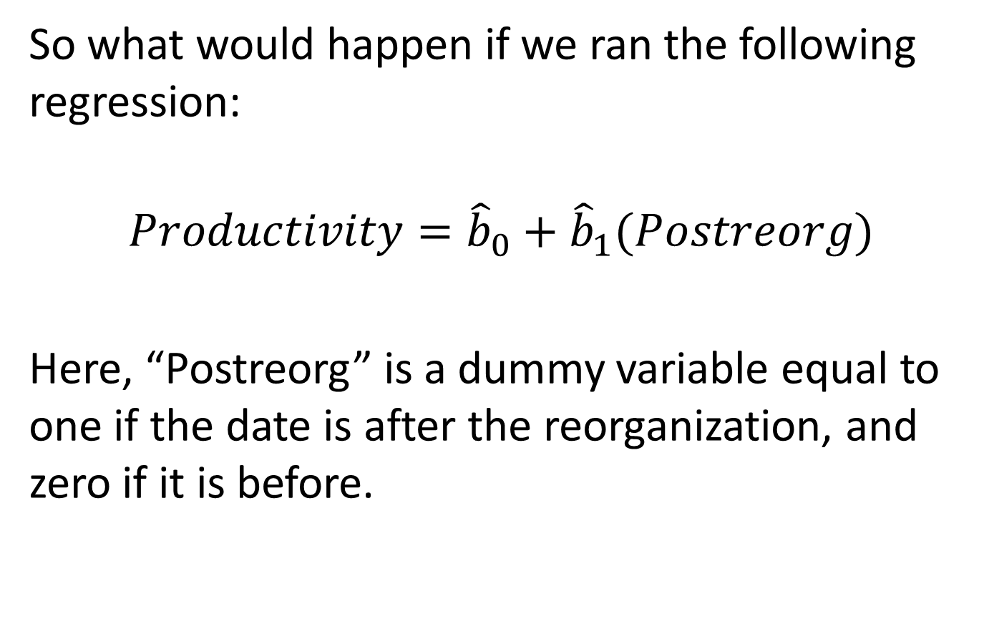
So what would happen if we ran the following regression:
$$Productivity={\hat{b}}_{0}+{\hat{b}}_{1}(Postreorg)$$
Here, “Postreorg” is a dummy variable equal to one if the date is after the reorganization, and zero if it is before.

Slide 61
Intuition (remember the earlier wage regression) for b₀
(1) What does the coefficient b₀ represent?
Remember the omitted reference category!
→When “postreorg” equals zero, then to which period does this refer?
The “pre”-reorganization period! And this is our “omitted reference category”

Slide 62
Intuition for b₀ (continued)
Given this, what does the coefficient b₀ represent?
In the same way that this coefficient represented the wages of “younger” workers in the wage regression case, it represents the average level of productivity in the pre-reorganization time period.

Slide 63
Intuition for b₁
What does b₁ represent?
In the same way that this coefficient represented the relative wages of “older” workers in the wage regression case, it represents the relative productivity of the firm in the post-reorganization time period.

Slide 64
Let’s try this
Load up “breaks.xls” in Excel and let’s see if there are “real” changes in examples 1, 2 or 3. The data set contains three productivity trends (“productivity1”, “productivity2” and “productivity3”) which correspond to the prior three examples. And the variable “Postreorg” is the dummy variable we discussed on the prior slide.

Slide 65
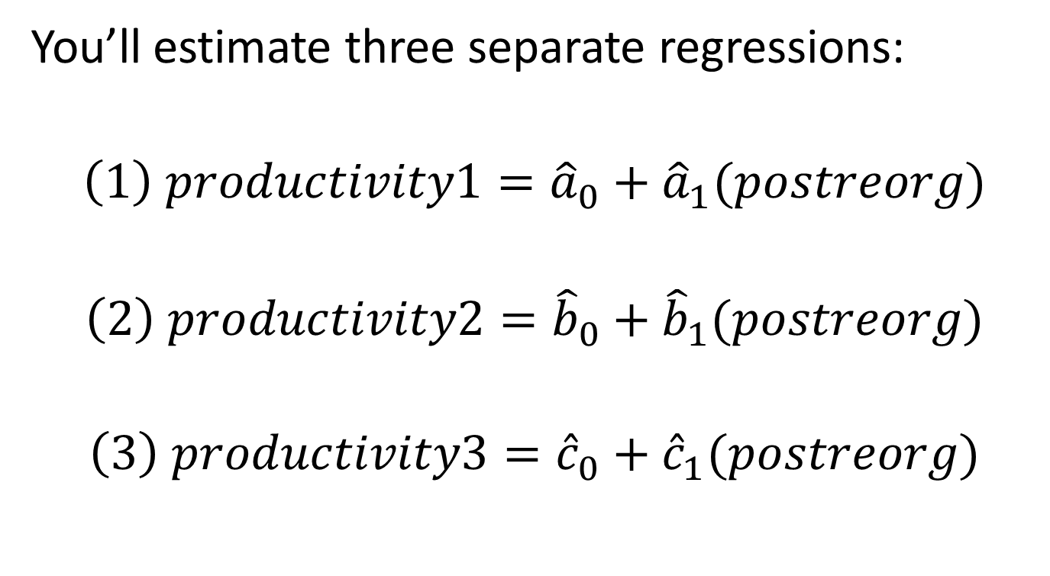
Let’s try this
You’ll estimate three separate regressions:
$$\left(1\right) productivity1={\hat{a}}_{0}+{\hat{a}}_{1}(postreorg)$$
$$\left(2\right) productivity2={\hat{b}}_{0}+{\hat{b}}_{1}(postreorg)$$
$$\left(3\right) productivity3={\hat{c}}_{0}+{\hat{c}}_{1}(postreorg)$$

Slide 66
Results: Productivity1
R Square | 0.000256
Standard Error | 10.38677
Observations | 400
ANOVA | df | SS | MS
Regression | 1 | 10.99872 | 10.99872
Residual | 398 | 42938.24 | 107.885
Total | 399 | 42949.23
 | Coefficients | Standard Error | t Stat
Intercept | 10.27979 | 0.736299 | 13.96145
Postreorg | 0.331647 | 1.03869 | 0.319294

Slide 67
Results: Productivity2
R Square | 0.525399
Standard Error | 4.984329
Observations | 400
ANOVA | df | SS | MS
Regression | 1 | 10946.05 | 10946.05
Residual | 398 | 9887.729 | 24.84354
Total | 399 | 20833.78
 | Coefficients | Standard Error | t Stat
Intercept | 9.804779 | 0.35333 | 27.74965
Postreorg | 10.46247 | 0.498439 | 20.99046

Slide 68
Results: Productivity3
R Square | 0.529378
Standard Error | 3.993617
Observations | 400
ANOVA | df | SS | MS
Regression | 1 | 7140.199 | 7140.199
Residual | 398 | 6347.693 | 15.94898
Total | 399 | 13487.89
 | Coefficients | Standard Error | t Stat
Intercept | 10.34493 | 0.2831 | 36.5416
Postreorg | -8.45008 | 0.399367 | -21.1587

Slide 69
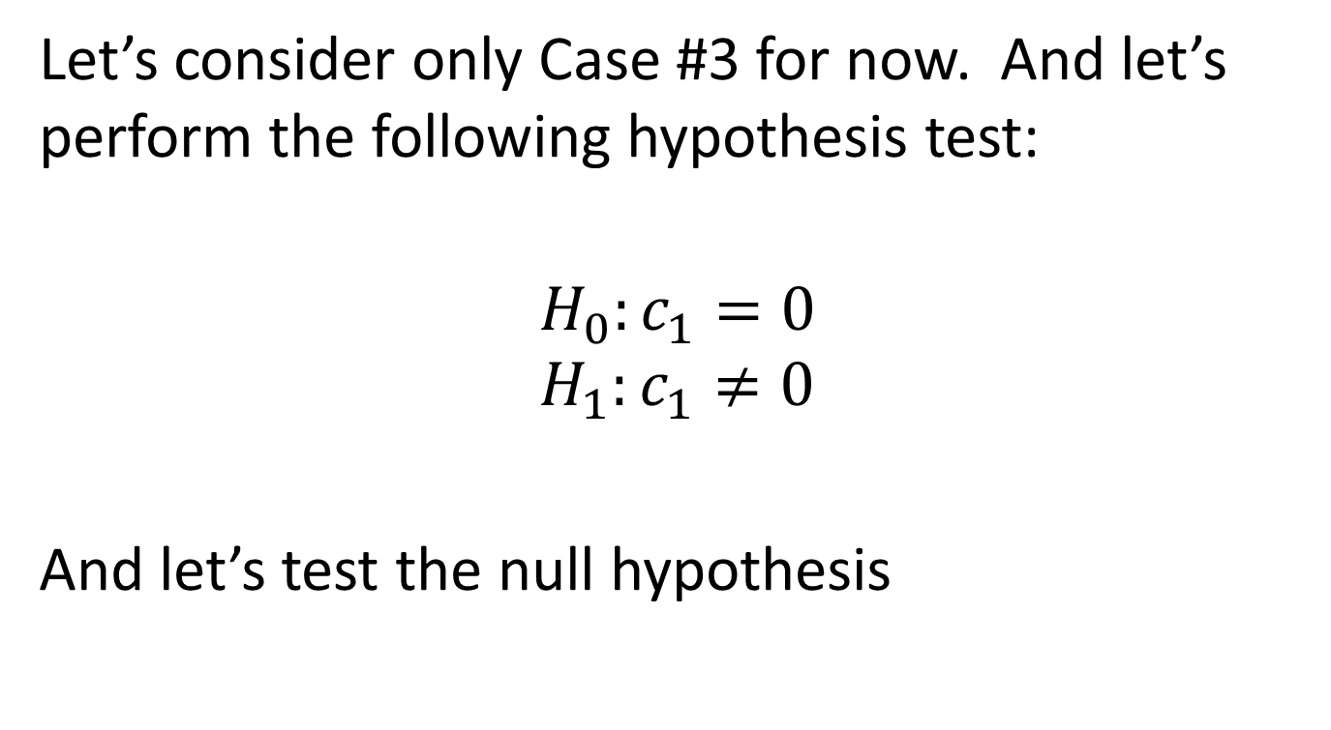
Hypothesis Test
Let’s consider only Case #3 for now. And let’s perform the following hypothesis test:
$$H_{0}:c_{1}=0$$
$$H_{1}:c_{1}≠0$$
And let’s test the null hypothesis

Slide 70
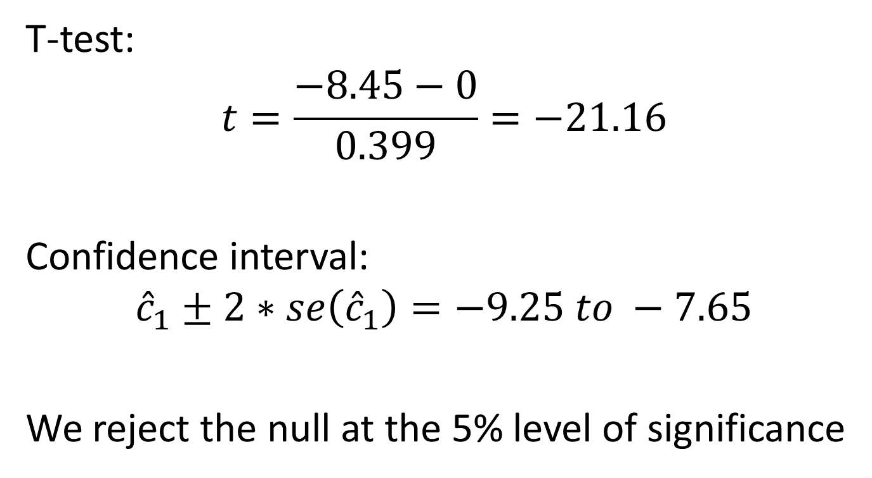
Hypothesis Test
T-test:
$$t=\frac{−8.45−0}{0.399}=−21.16$$
Confidence interval:
$${\hat{c}}_{1}±2∗se\left({\hat{c}}_{1}\right)=−9.25 to −7.65$$
We reject the null at the 5% level of significance

Slide 71
Graphical intuition
So what did we just estimate, and what does our hypothesis test show?
In this case, a picture is worth a thousand words. Let’s look at our data again. Here’s example #3 (or “Productivity3”).

Slide 72
It looked like this:

Slide 73
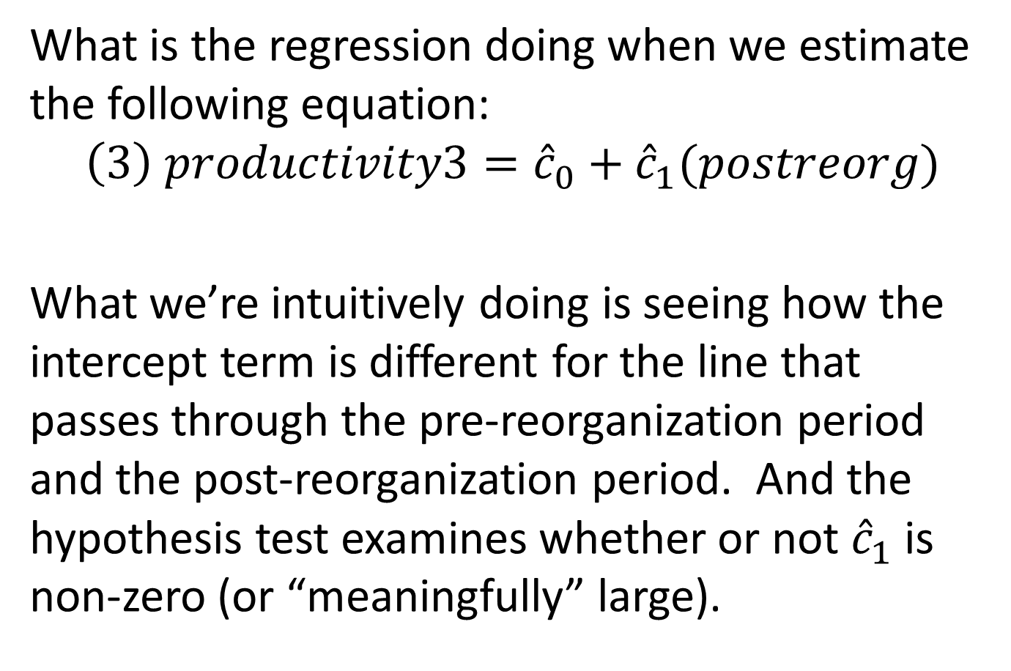
What is the regression doing when we estimate the following equation:
$$\left(3\right) productivity3={\hat{c}}_{0}+{\hat{c}}_{1}(postreorg)$$
What we’re intuitively doing is seeing how the intercept term is different for the line that passes through the pre-reorganization period and the post-reorganization period. And the hypothesis test examines whether or not ${\hat{c}}_{1}$ is non-zero (or “meaningfully” large).

Slide 74
“Pre” mean
“Post” mean

Slide 75
The coefficient on “Postreorg” is the vertical difference between the two horizontal lines.
This is good to know, since it’s the effect of the change in organizational policies.

Slide 76
“Pre” mean
c₁
“Post” mean

Slide 77
A bigger question
This is great, because we’ve devised a way to measure changes in an outcome before and after some change.
But now we need to think about the notion of causality. We need to consider whether or not we can attribute the change in the outcome to the change in some variable we can control.

